Slide 1


B V RAJU INSTITUTE OF TECHNOLOGY
(UGC Autonomous) Vishnupur, Narsapur, Medak District
Department of Computer Science and Engineering
Minor Project – Final Review
“Generative AI-Based Smart Community Tool Sharing System”
By:
Guided By:
Mahesh Kumar Challa MTech(Ph.D) Assistant Professor
24211A0584 : B. Saikiran
24211A0586: Ch. Pranay kumar
24211A05B0 : Ch. Mahasri Reddy 24211A05A5 : Ch. Rohith Reddy

Slide 2
Outline
Abstract
Introduction
Literature Survey
Existing System
Problem Statement & Objectives
Proposed List of Modules
Proposed System Architecture diagram
Proposed Algorithm Working Steps.
Proposed Data Flow diagram
UML Diagrams
Results & Discussion
Conclusion & future Enhancement
References

Slide 3
Abstract
Tool Share is a smart community-based tool sharing system designed to help people rent and lend tools within their local area. Many people buy tools such as drills, ladders, gardening tools, and repair equipment for short-term use, but these tools remain unused after the work is completed. At the same time, nearby users may need the same tools for a limited period. The proposed system connects tool owners and borrowers through a simple web platform. It includes user registration, login, tool request management, owner approval, payment details, refundable security deposit, verification, and review features. The system also uses Generative Al to suggest suitable tools based on the borrower's requirement, making the process easier for users who know the task but do not know the exact tool name. Tool Share reduces unnecessary purchases, promotes local sharing, saves money, and improves trust between users through a structured borrowing and lending process.

Slide 4
Introduction
Tool Share is a smart community-based web platform that allows people to share tools with others in their nearby area. It is designed to connect tool owners and borrowers in a simple and organized way.
In daily life, many people buy tools such as drilling machines, ladders, cutters, gardening tools, and repair equipment for temporary use. After completing the work, these tools often remain unused at home for a long time.
Tool Share helps solve this problem by allowing owners to rent their unused tools to nearby users who need them for a short period. This helps borrowers save money and helps owners earn from tools they already have.
The system includes features such as registration, login, tool request, owner approval, payment details, refundable security deposit, verification, and reviews. It also uses Generative AI to suggest suitable tools based on the user’s requirement.

Slide 5
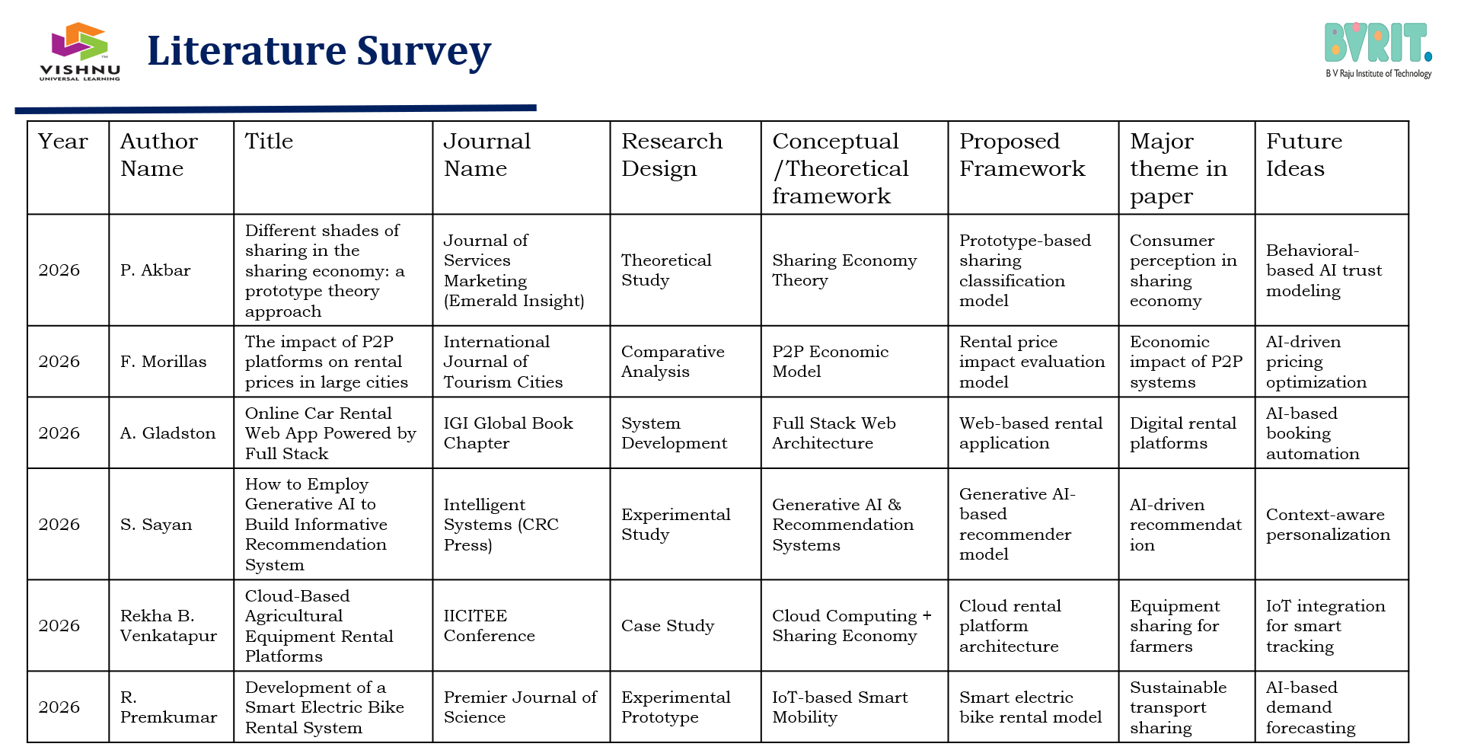

Slide 6
Existing system
People usually borrow tools from friends, neighbours, or relatives without any proper digital platform.
Existing methods do not provide request status, owner approval, payment record, security deposit, or proof of tool handover.
Users may not easily find the required tool nearby, and there is no proper system to ensure safety, responsibility, and damage protection.

Slide 7
Problem Statement & Objectives
Problem Statement:
Many people buy tools for short-term use, but after completing the work, those tools remain unused at home.
Nearby users may need the same tools temporarily, but they may not know who owns them in their locality.
Existing borrowing methods depend on friends, neighbours, or informal groups, which are not always reliable.
Objectives :
To connect local tool owners and borrowers through a simple web-based platform.
To reduce unnecessary tool purchases by allowing users to rent tools for short-term needs.
To provide a structured borrowing process with request, approval, payment, deposit, verification, and return flow.
To improve trust and safety using owner approval, security deposit, proof verification, and review system.
To use Generative Al support for suggesting suitable tools based on the borrower's requirement.

Slide 8
Proposed List of Modules
User Module:
Allows users to register and log in.
Stores user details such as name, email, role, and location.
Request Module:
Handles sending tool borrow requests.
Tracks request details, status, and request history.
Approval Module:
Allows tool owners to accept or reject requests.
Updates the request status accordingly.
Payment Module:
Manages rent amount, deposit amount, and payment details.
Tracks payment submission, confirmation, and transaction status.
Verification Module:
Handles uploading and storing verification videos or proofs.
Ensures safer borrowing and return process between users

Slide 9
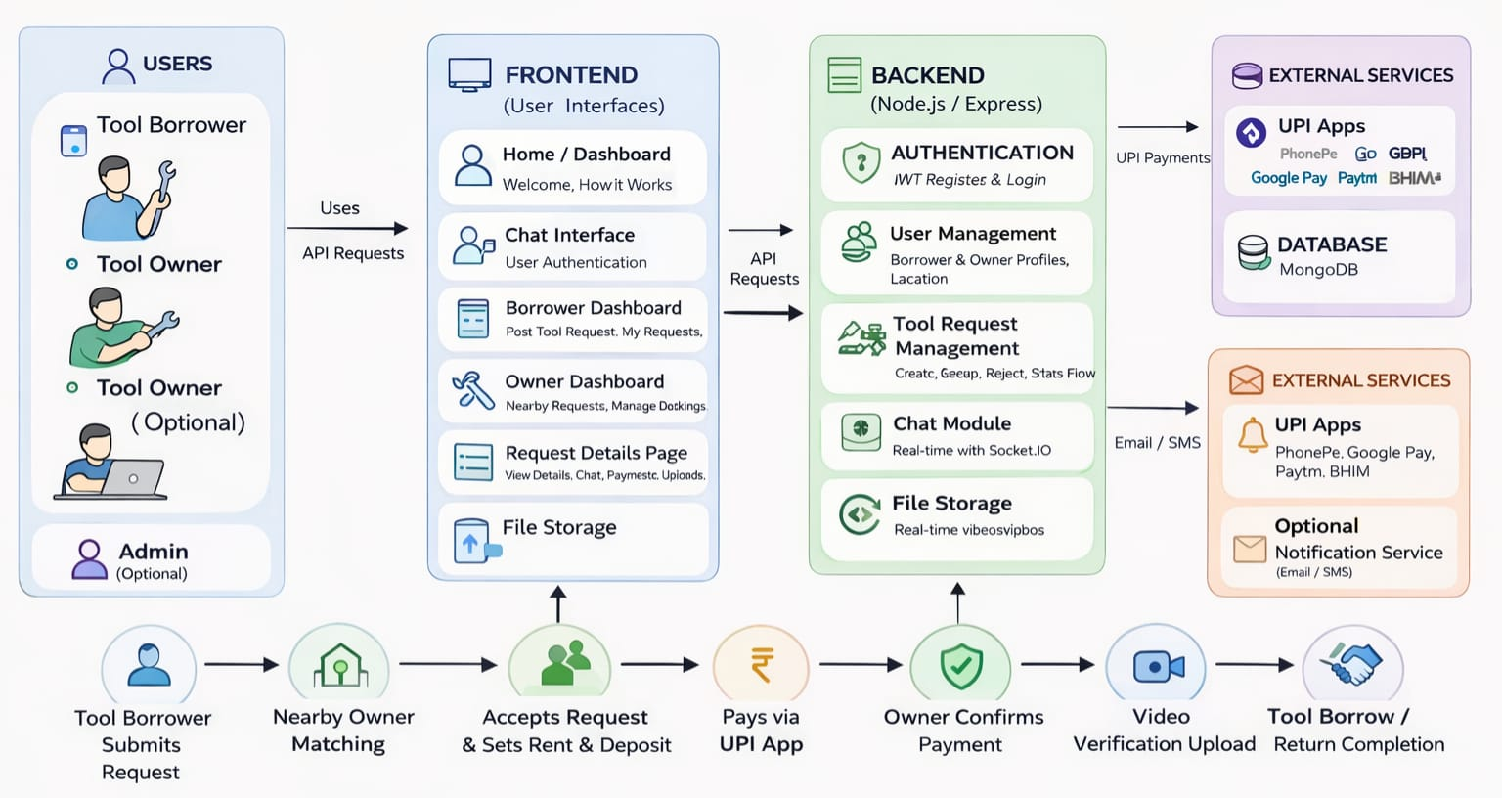
Proposed Architecture diagram

Slide 10
Proposed Algorithm Explanation
Step 1: User Authentication User registers or logs into the system. System validates user credentials.
Step 2: Tool Search & Selection User searches for required tools. System displays available tools.
Step 3: Request Submission User selects a tool and sends a borrow request. Request is stored in the system.
Step 4: Owner Approval Process Tool owner reviews the request. Owner approves or rejects the request.

Slide 11
Proposed Algorithm Explanation
Step 5: Notification Handling System notifies user about request status. User receives approval or rejection alert.
Step 6: Tool Transaction If approved, tool is handed over to user. User uses the tool and returns it.
Step 7: Completion & Feedback System updates transaction status. User provides rating and feedback.

Slide 12
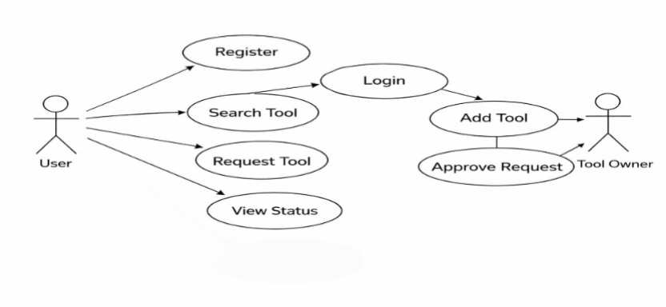
UML Diagram (Use Case Diagram)

Slide 13
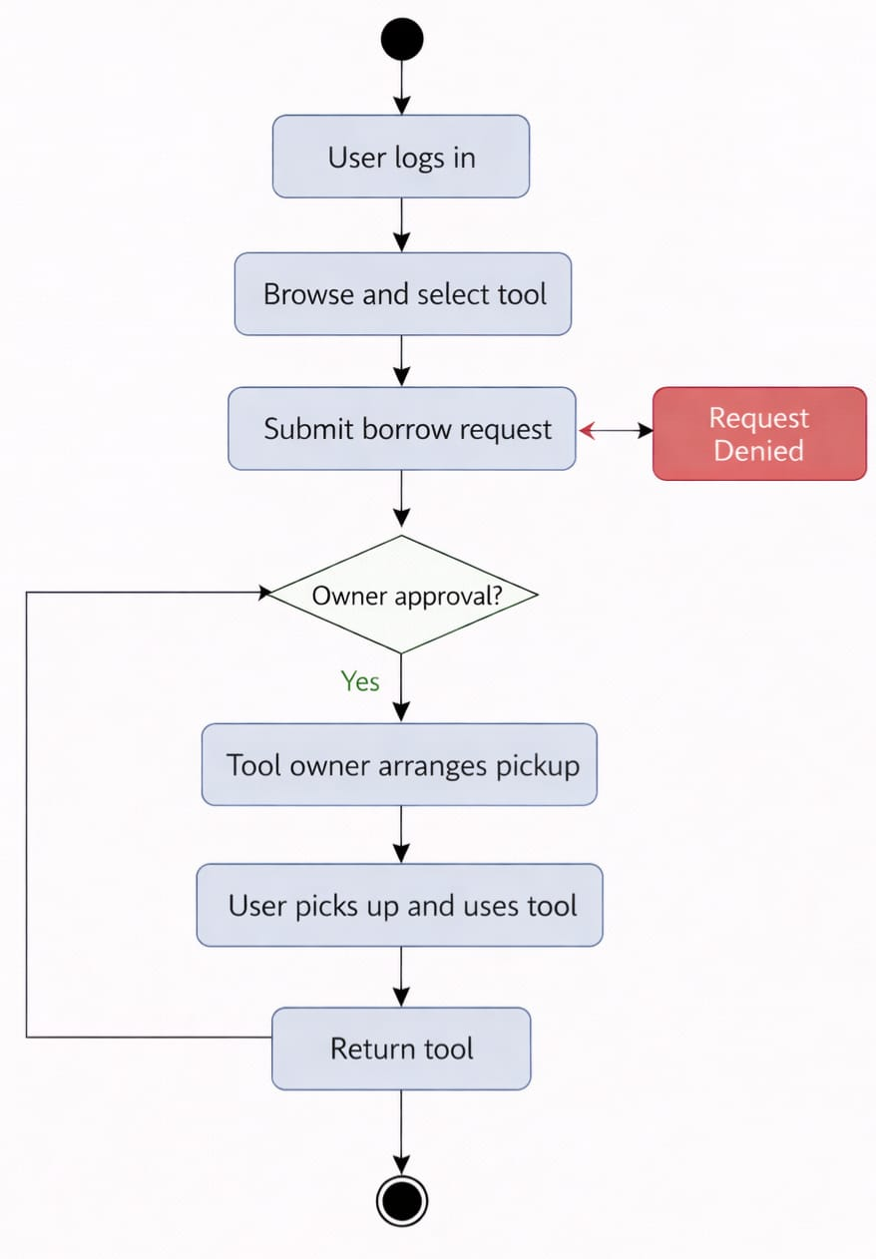
UML Diagram (Activity Diagram)

Slide 14
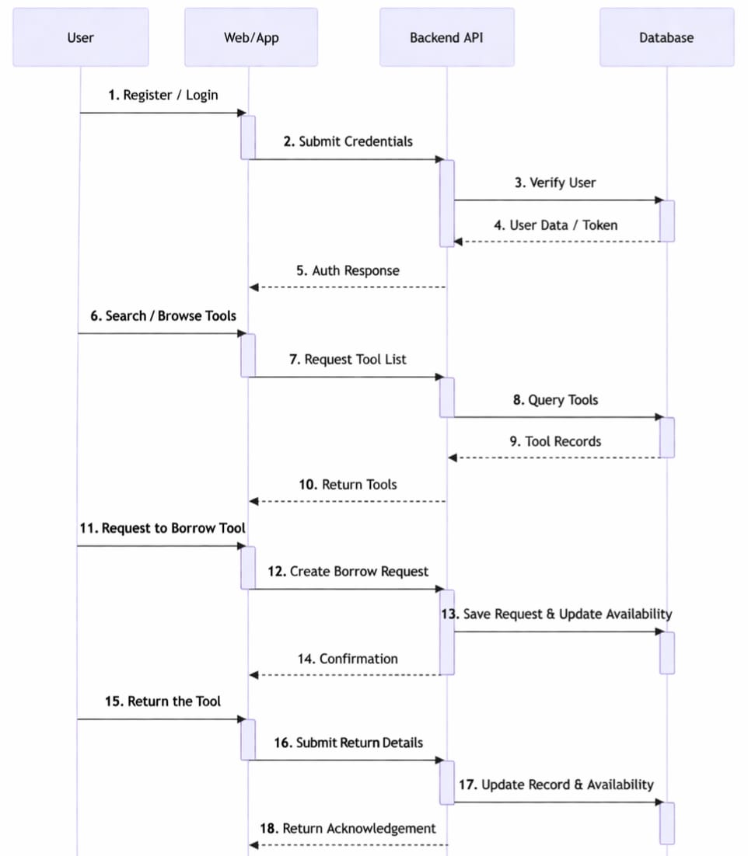
UML Diagram (Sequence Diagram)

Slide 15
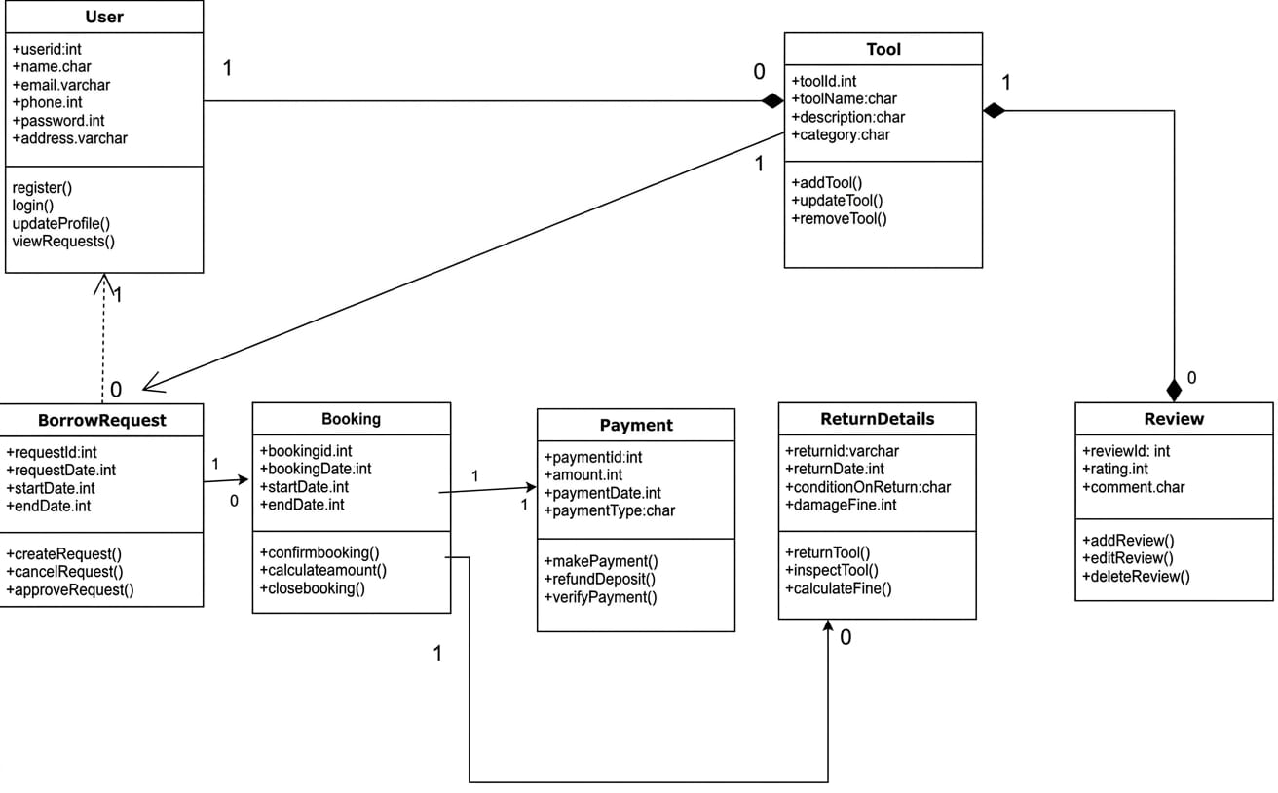
UML Diagram (Class Diagram)

Slide 16
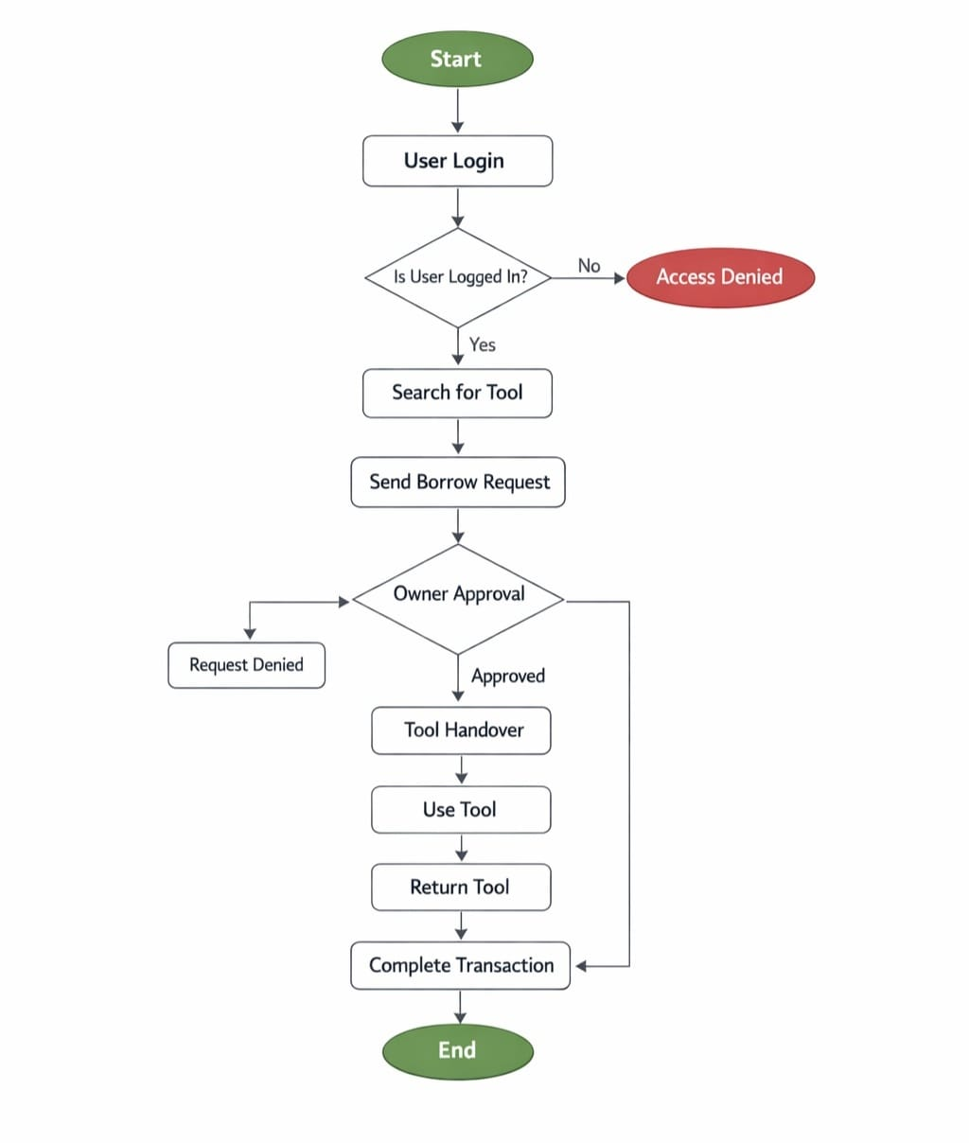
Proposed Flow diagram

Slide 17
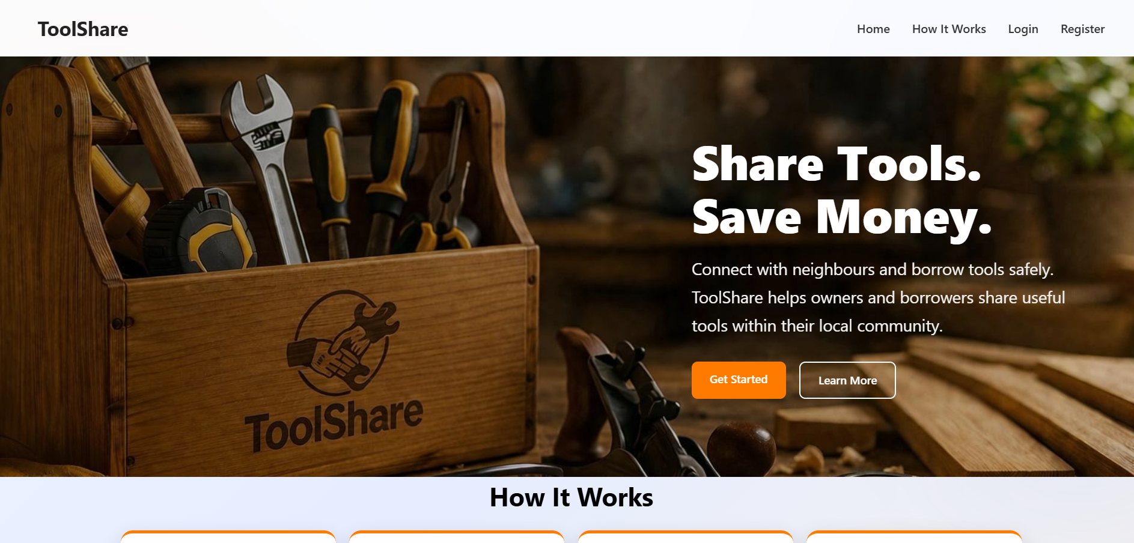
Results and Discussions
Implementation screenshots :

Slide 18
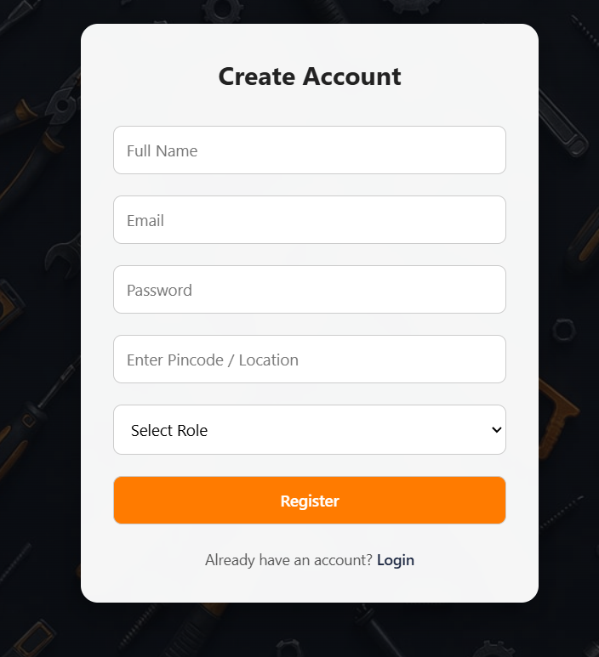
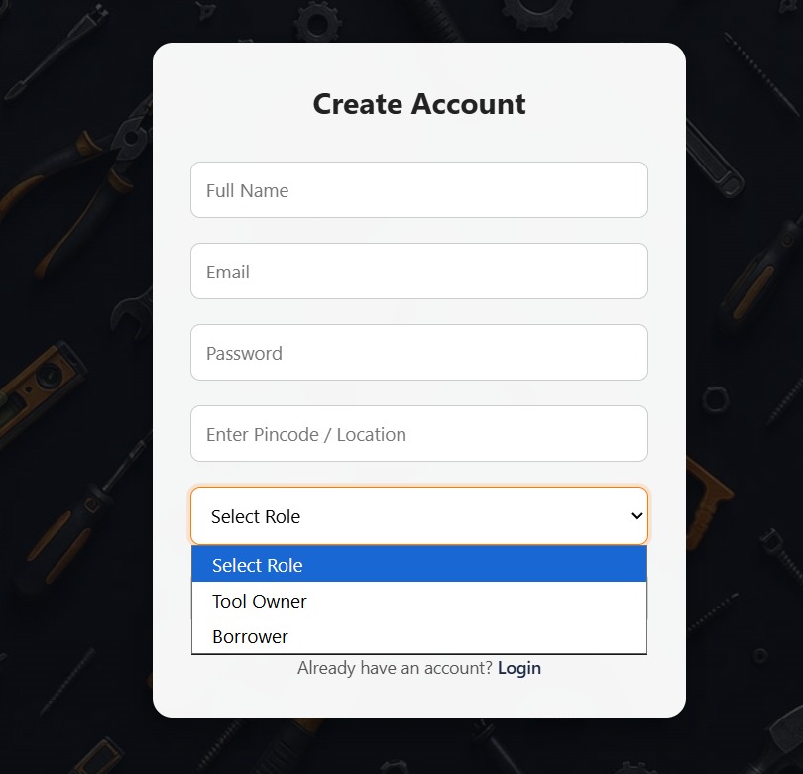
Results and Discussions

Slide 19
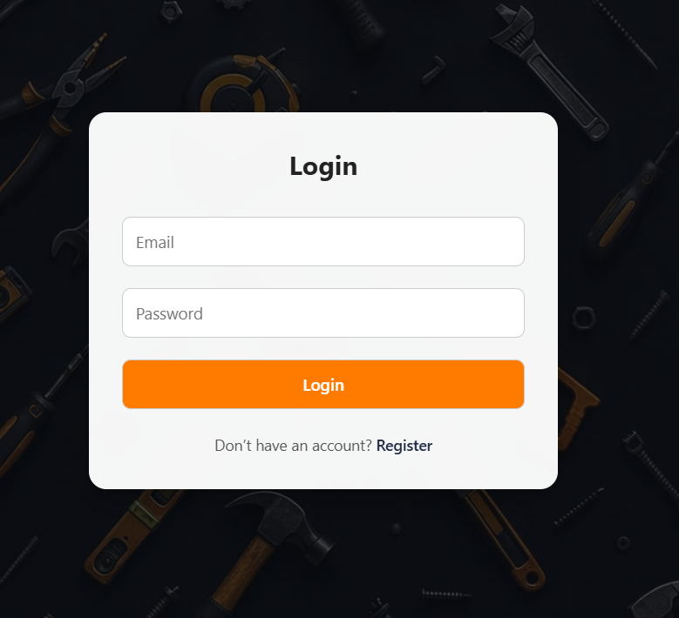
Results and Discussions

Slide 20
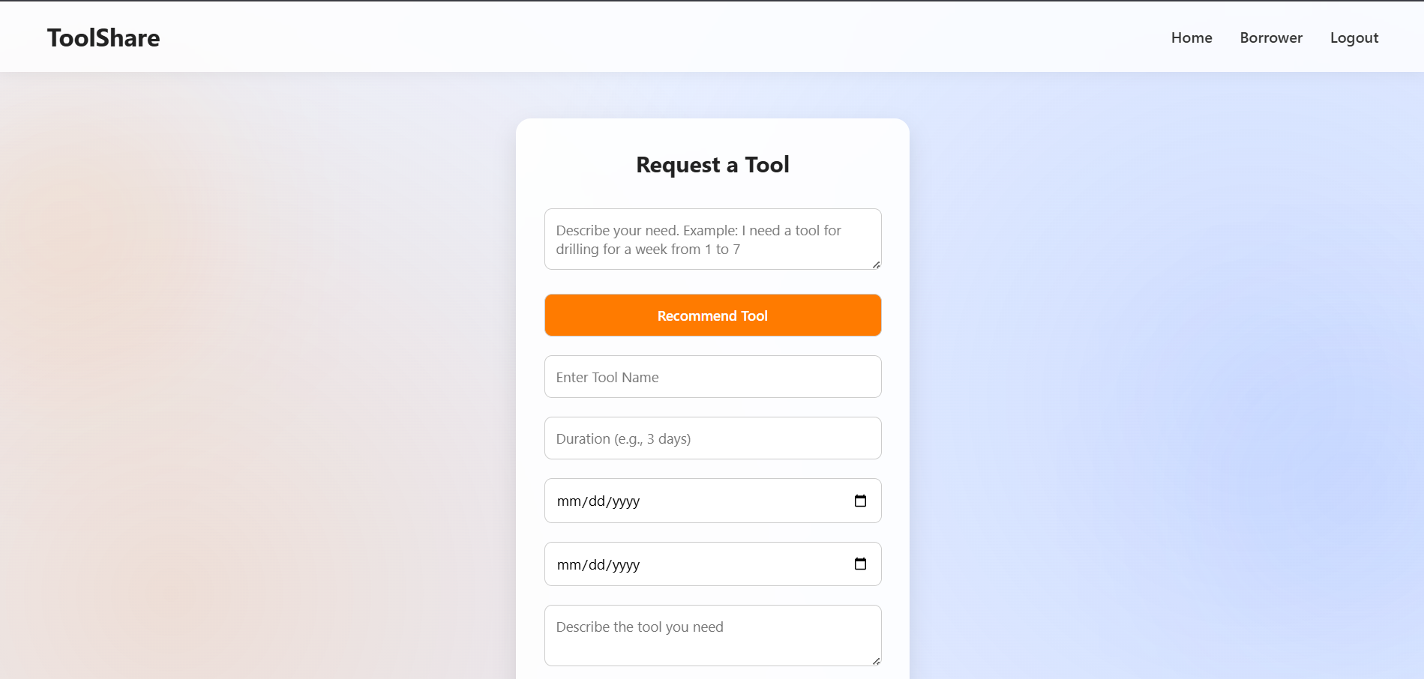
Results and Discussions

Slide 21
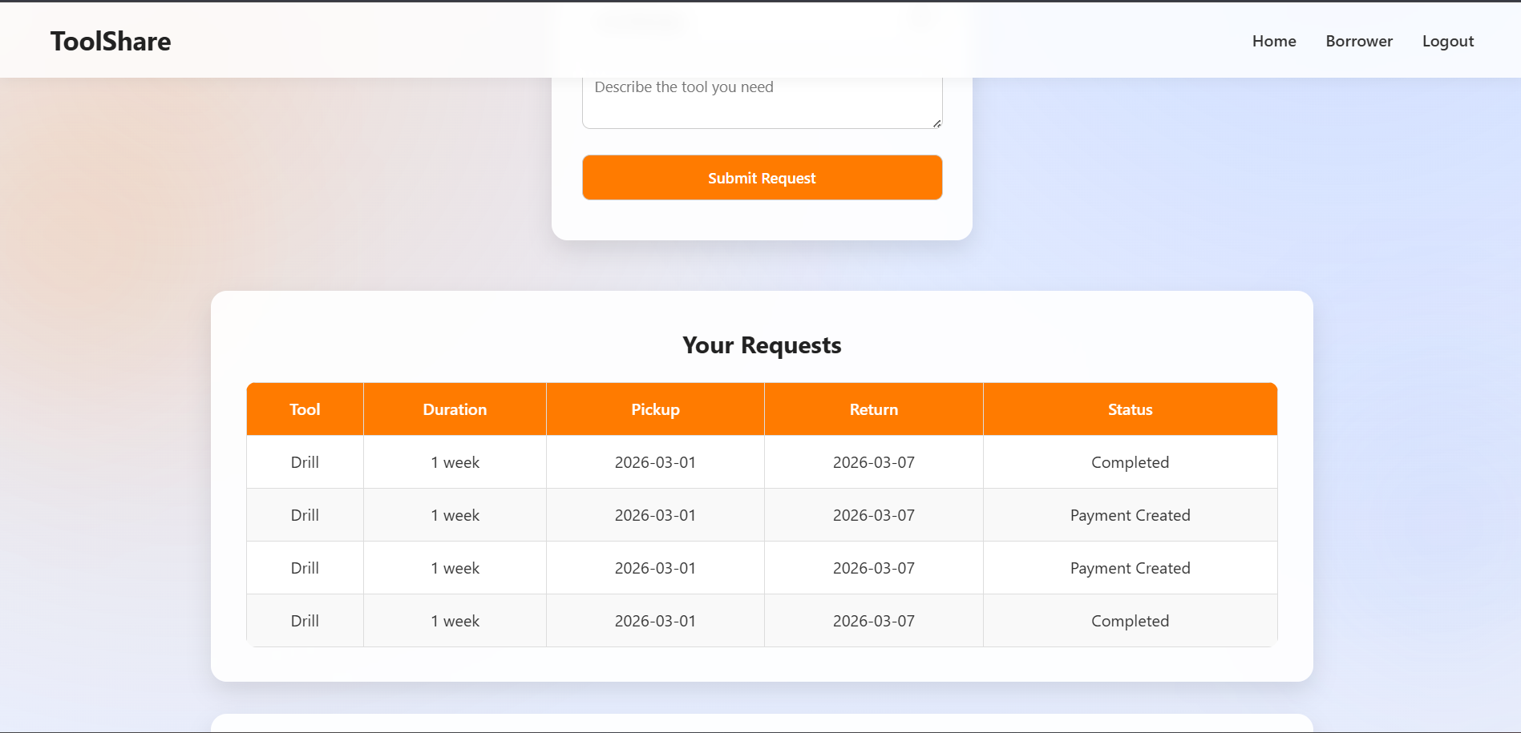
Results and Discussions

Slide 22
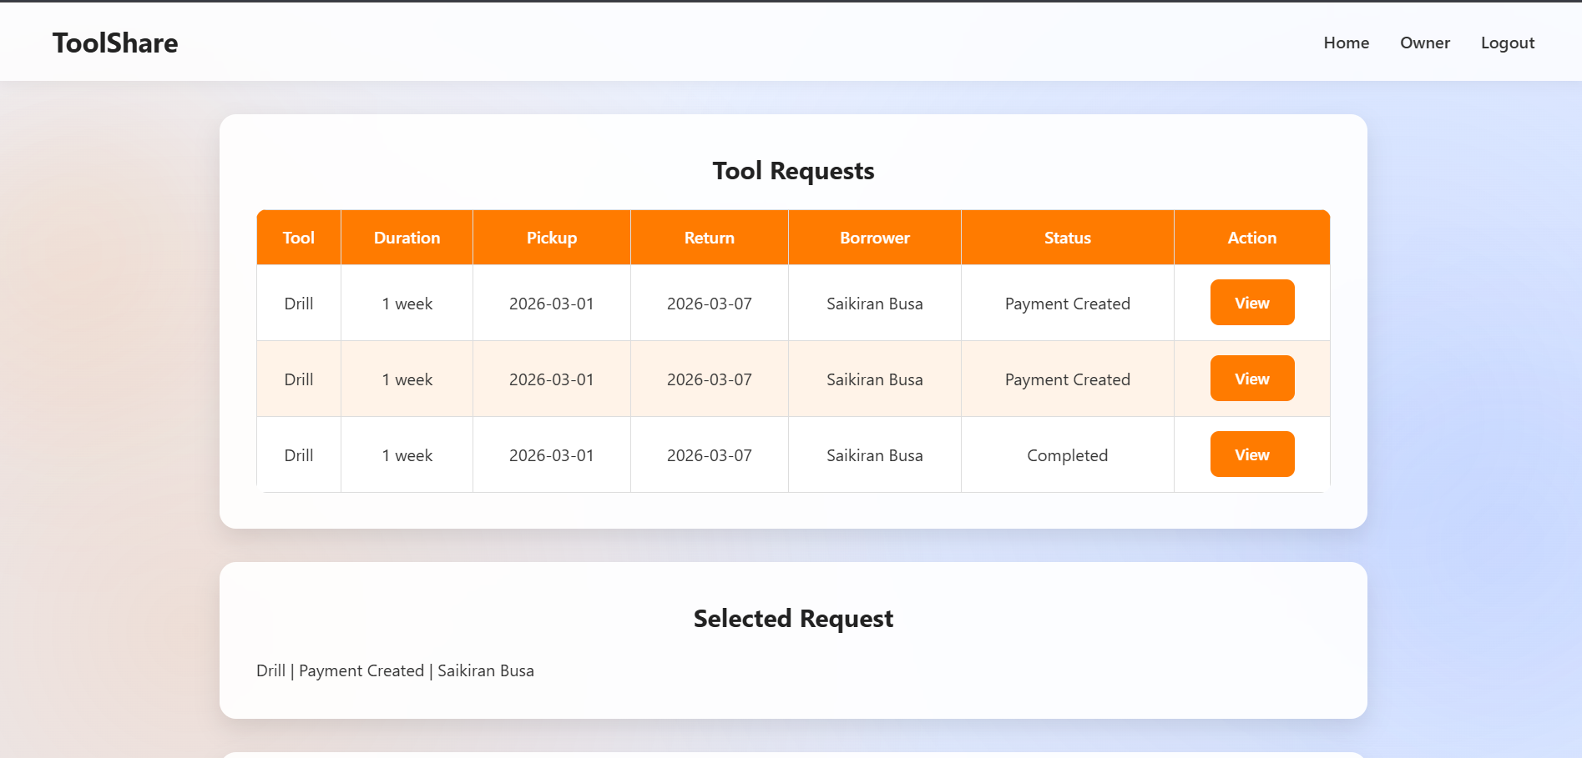
Results and Discussions

Slide 23
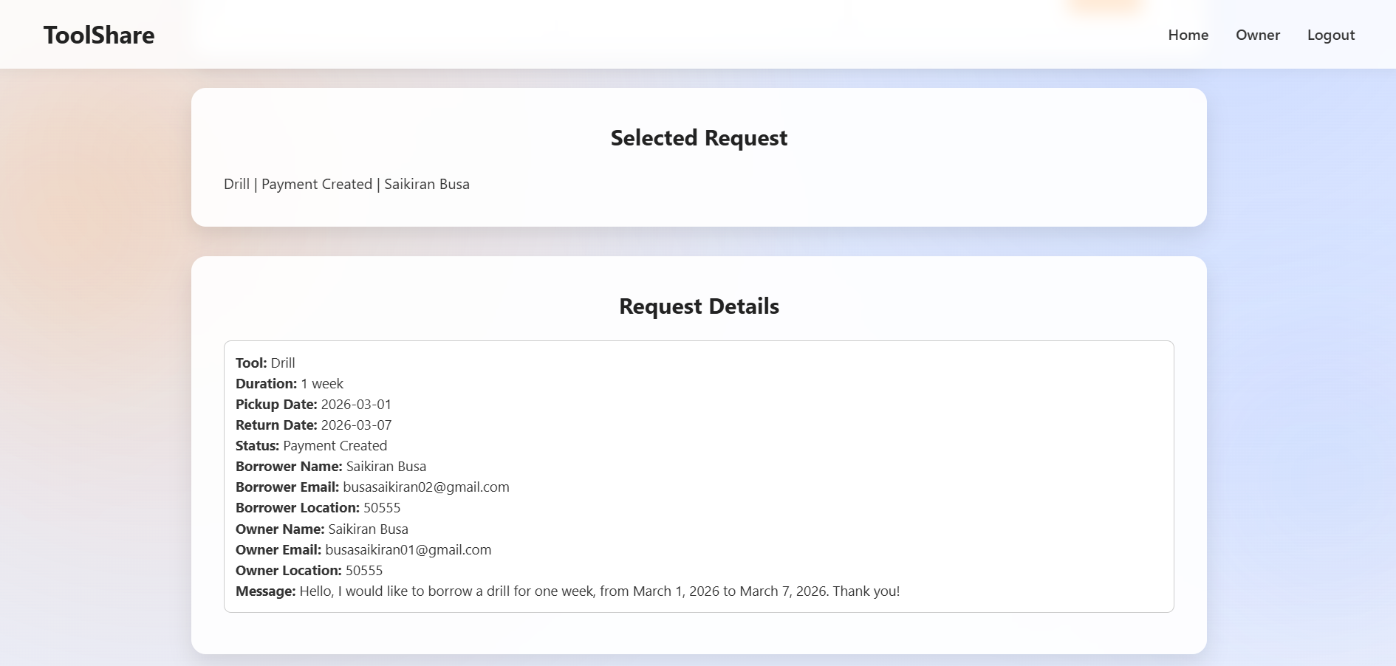
Results and Discussions

Slide 24
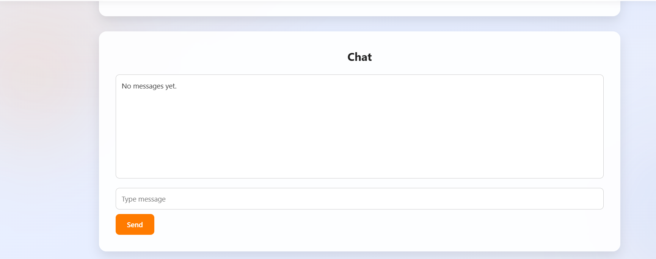

Results and Discussions

Slide 25
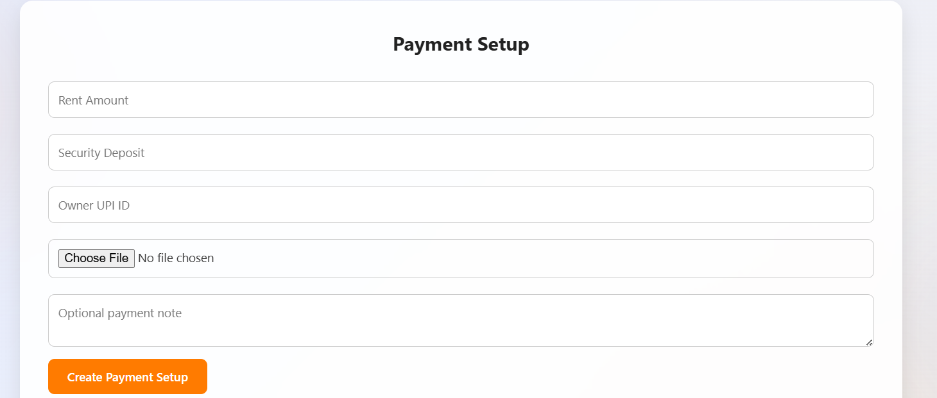
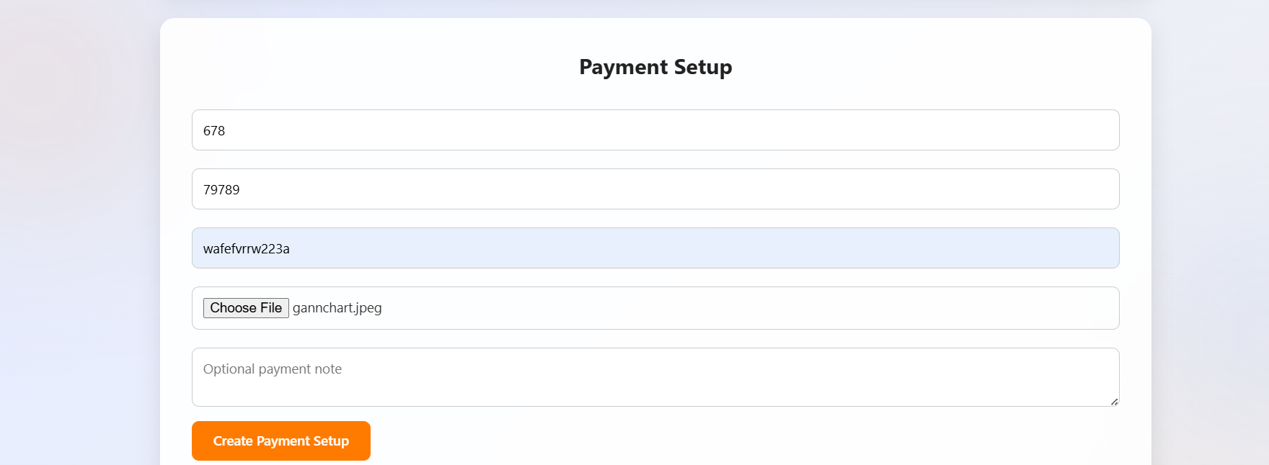
Results and Discussions

Slide 26
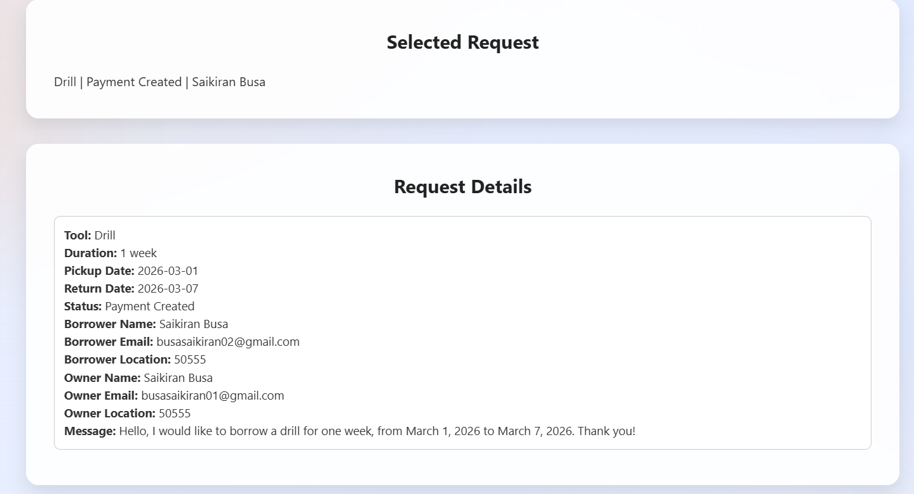
Results and Discussions

Slide 27
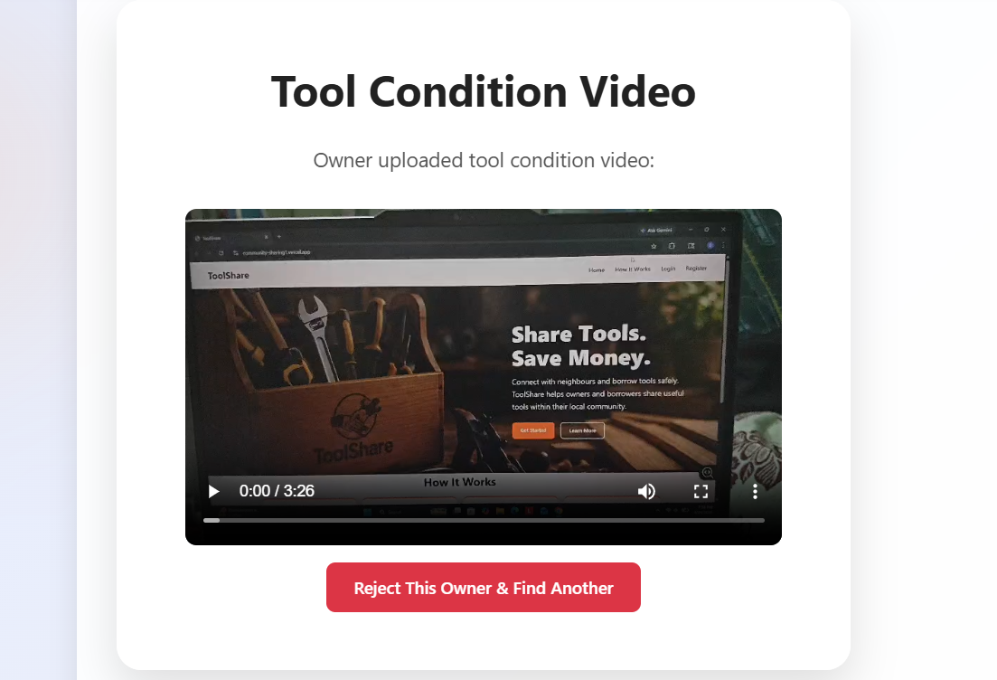
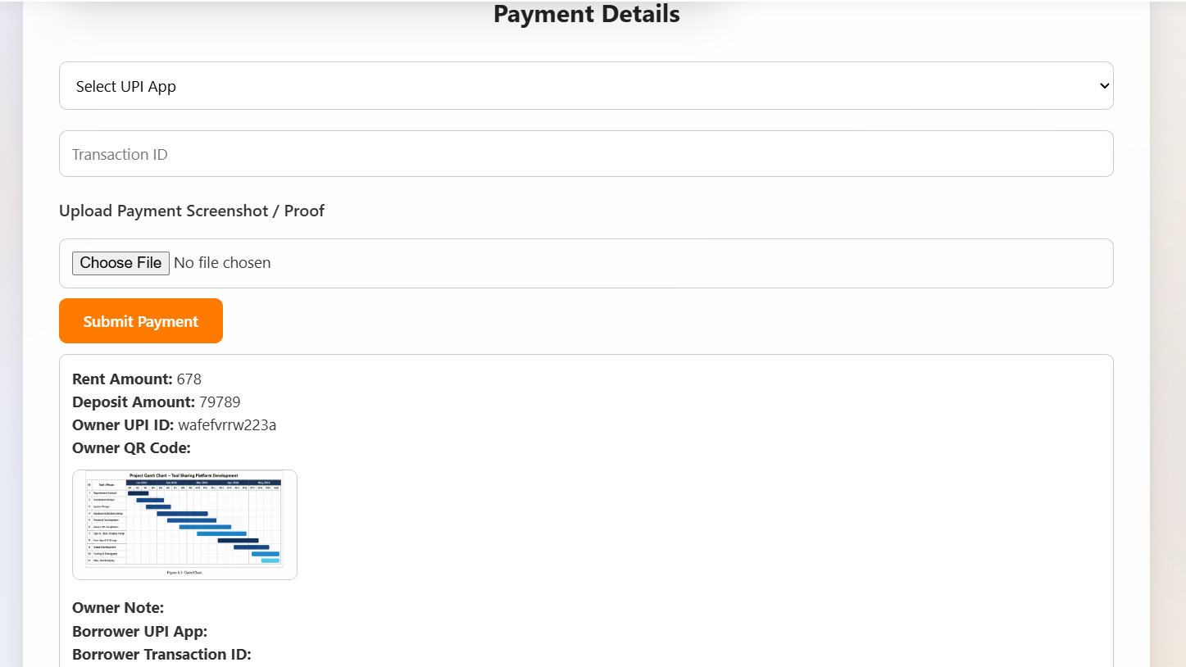
Results and Discussions

Slide 28
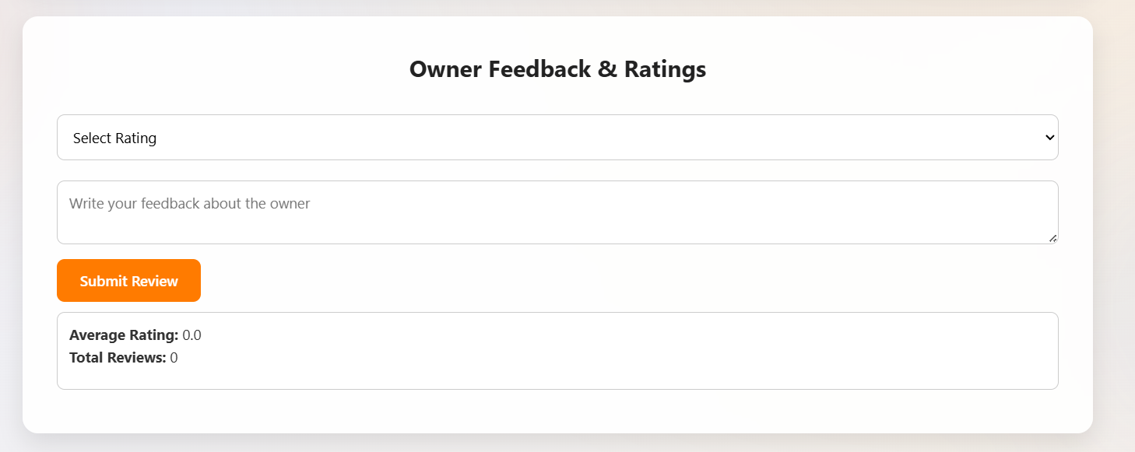
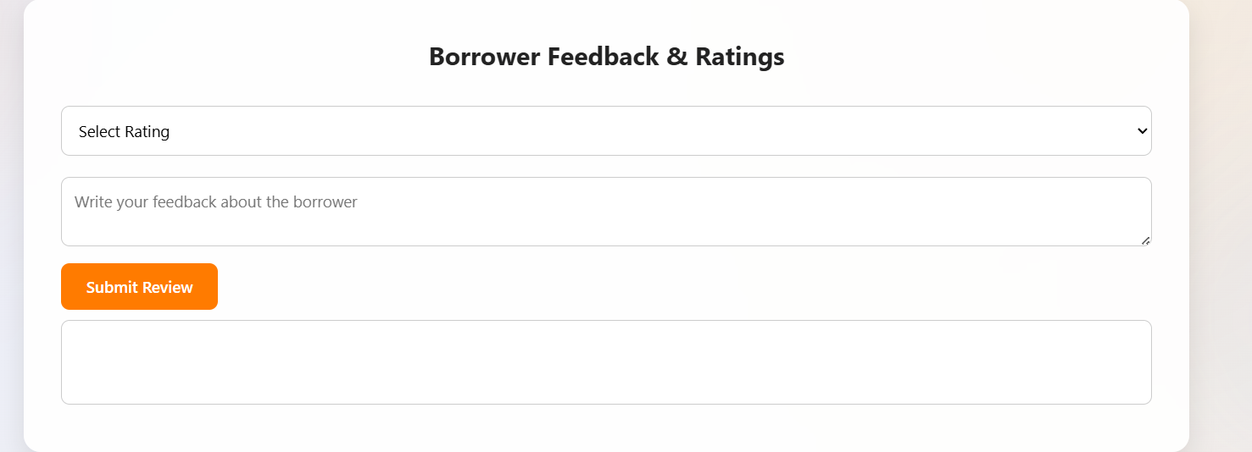
Results and Discussions

Slide 29
Conclusion and Future Enhancement
Conclusion
Tool Share provides a simple and organized platform for connecting local tool owners and borrowers, helping users rent tools instead of buying them for short-term use.
The system improves trust and safety through owner approval, payment details, refundable security deposit, verification, and review features.
Future Enhancements
GPS-based location matching and amobile application can be added to make tool searching and borrowing more accurate and convenient.
Advanced Generative Al features such as chatbot support, automatic tool suggestions, and price estimation can be improved in future versions.

Slide 30
References
[1] P. Akbar, "Different shades of sharing in the sharing economy: a prototype theory approach, Journal of Services Marketing, Emerald Insight, pp. 1-16, Jan. 2026.
[2] F. Morillas, J. M. Pastor, and L. Serrano, "The impact of P2P platforms on rental prices in large cities: a comparative analysis," International Journal of Tourism Cities, Jan. 2026.
[3] A. Gladston, A. S. Bharghavi, and S. Nivethitha, "Online Car Rental Web App Powered by Full Stack,"Practical Frameworks for New-Age Digitalization Business Strategy, IGI Global, ch. 12, 2026.
[4] S. Sayan, S. Sahoo, T. Patwari, S. Samanta, and A. Mondal, "How to Employ Generative AI to Build informative Recommendation System," Intelligent Systems, CRC Press, 1st Ed., pp. 17, 2026.
[5] Rekha B Venkatapur, Sinchana M, Vamshi N M, Veena M, and Vikram S, "Cloud-Based Agricultural Equipment Rental Platforms: Bridging the Gap Between Farmers and Machinery," 2026 International Conference on Intelligent and Innovative Technologies in Computing, Electrical and Electronics (IITCEE), Jan. 22-23, 2026.

Slide 31
[6] Premkumar, N. Pushpalatha, P. Palpandian, S. Karthikraja, K. Rameela, S.Somasundaram, and
S.Gowtham,"Development of a Smart Electric Bike Rental System: An Experimental Study," Premier
Journal of Science, Jan. 31, 2026.
[7] K. Jindal, H. Kharb, and R. K. Nirala, "P2P-SFS: Secured Peer-to-Peer File Sharing with End to-
End Encryption and Authentication," 2026 International Conference on Intelligent and innovative
Technologies in Computing, Electrical and Electronics (IITCEE), Jan. 2025.
[8] R. Adinoval, R. M. Maharani, and A. Jazuli, "Development of a Web Base Badminton Court
Rental Information System with the Laravel Framework, "International Journal of Science and
Environment (IJSE), vol. 6, no. 1, Feb. 2024.
[9] S. Ansari, P. Abhang, P. Gaikwad, V. Gidhad, A. Karad, and A. Sanap, "Online Rentals Things,"
International Journal of Advanced Research in Science, Communication and Technology (IJARSCT), vol. 3,
no. 3, Dec. 2023.

Slide 32
Thank You ………..

